Slide 1
Merging data files in SPSS
Henk van der Kolk

Slide 2
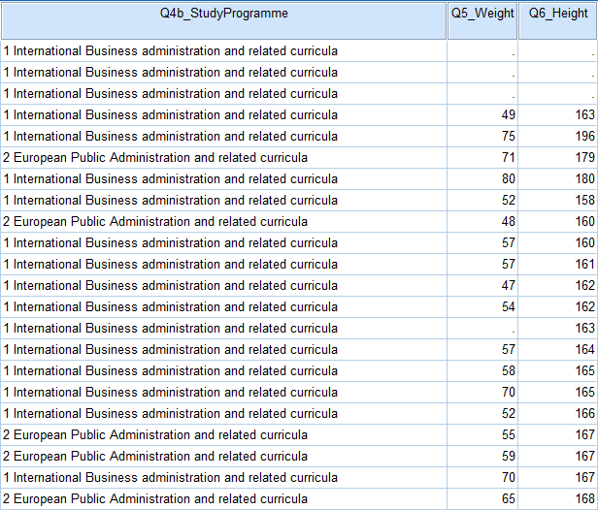
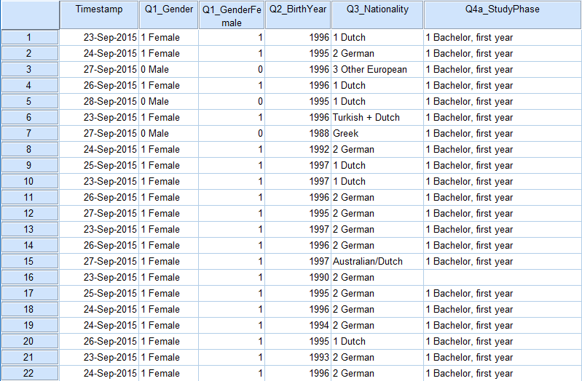
Aim
Merging datamatrices in SPSS

Slide 3
When do we need to merge datafiles?
Same units of observation, other variables (Example: two different surveys with the same respondents)
Similar units of observation, the same variables (Example: two identical surveys with other respondents)
Both

Slide 4
Same units, other variables
Variables 1-10
Variables 11-20
Identification of the unit in both files
Units A-G
Units A-G

Slide 5
Similar units, same variables
Variables 1-10
Units A-G
Same variable names
Variables 1-10
Units H-Z

Slide 6
Similar & same units, same & other variables
Variables 1-10
Units A-G
Variables 5-15
Units F-X

Slide 7
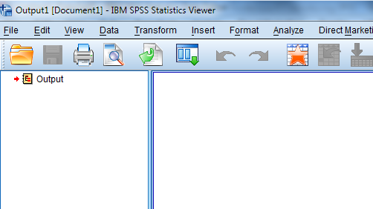
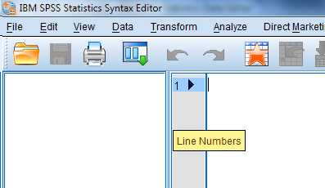
Menu
Data(matrix) (.sav)
or
Output (.spv)
Syntax file (.sps)

Slide 8
Menu
Data(matrix) (.sav)
or
Transforming the data matrix
Syntax file (.sps)

Slide 9
Things that can go wrong
Datafiles do not contain similar units of observation
Datafiles with similar units only contain other variables
Datafiles with similar units and some identical variables use other variable names

Slide 10
Other units, other variables
Variables 1-10
Variables 11-20
Units at
level 2
Units at level 1

Slide 11
When do we need to merge datafiles?
IV. Nested units (Example: adding information about municipalities to individuals living in these municipalities)

Slide 12
Merging data files in SPSS

