Slide 1
In this microlecture
Linear relationships
Dichotomous variable
Probability
Odds
Log(odds)

Slide 2
The problem (1)
A continuous (ratio or interval) variable
A latent trait OR an independent variable
Is related to a
Dichotomous outcome variable

Slide 3
The problem (2)
Example I:
mathematical knowledge (latent trait) and
answer to a question in an exam (incorrect/correct) (item)
Example II:
Age (in years) (independent variable) and
voting in an election (no/yes) (dependent variable)

Slide 4
Linear function
Linear relationship between:
𝛳 (latent trait) and item score
X (independent variable) and Y (dependent variable)
Assume:
item / dependent variable is continuous (scale/ratio)

Slide 5
Linear relationship
Item/dependent variable
b₁
b₀
𝛳 (latent trait) or X (independent variable)
Notes:
Example: education (X) and income (Y)
item characteristic curve

Slide 6
Back to the problem
1
Observations here
Item/dependent variable
Dichotomy
0
Observations here
𝛳 (latent trait) or X (independent variable)
Notes:
Mathematical knowledge and answer to a specific question (incorrect/correct)
Income and voting in an election (no / yes)

Slide 7
Back to the problem
1
Observations here
Item/dependent variable
Dichotomy
0
Observations here
𝛳 (latent trait) or X (independent variable)
Notes:
Suppose perfect relationship

Slide 8
Problems
Estimating a (linear) relationship
between a ratio variable and a dichotomous variable
Prediction (line) is also between 0 and 1
Prediction line extends below 0 and above 1
while observations are ONLY 0 or 1.

Slide 9
Solving the problem of a dichotomous variable
Step 1: thinking in terms of probabilities/proportions
Step 2: taking the odds of the probabilities
Step 3: taking the natural logarithm of the odds
Step 4: interpreting outcome as being about probabilities

Slide 10
Step 1: from yes/no to proportions /probabilities
p = chance of giving a correct answer, or
p = proportion of people giving a correct answer

Slide 11
Proportion
Dichotomy
1
100
5
5
30
70
95
95
Item/dependent variable
50
30
5
0
95
95
70
30
5
5
𝛳 (latent trait) or X (independent variable)

Slide 12
Dichotomy
Proportion
1
100
5
5
30
70
95
95
Item/dependent variable
50
5
0
95
95
70
30
5
5
𝛳 (latent trait) or X (independent variable)

Slide 13
Step 2: from probabilities to odds
Not using probabilities, but odds.
Odds are defined by:
$$\frac{p}{1−p}$$

Slide 14
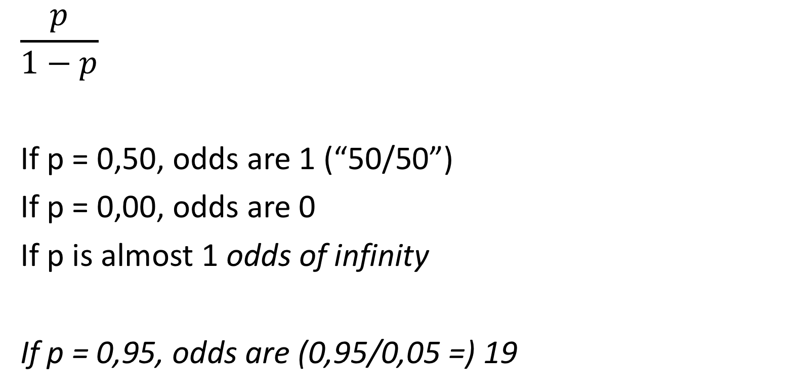
Step 2: from probabilities to odds
$$\frac{p}{1−p}$$
If p = 0,50, odds are 1 (“50/50”)
If p = 0,00, odds are 0
If p is almost 1 odds of infinity
If p = 0,95, odds are (0,95/0,05 =) 19

Slide 15
Dichotomy
Proportion
odds
1
100
∞
19
2.33
Item/dependent variable
50
1
30
5
0
0
𝛳 (latent trait) or X (independent variable)

Slide 16
Step 3: from odds to log(odds) (ln(odds))
Transforming odds by taking the natural log (log(odds))
Log(“odds are 1 (so a 50/50 chance”) = log(1) = 0.
What we do now, is say:
“The log(odds) gives us a variable with many values between – infinity and + infinity, that acts like a ratio variable”
Notes:
You could see it as a trick, but it works, as we will show later …

Slide 17
Step 3: from odds to log(odds) (ln(odds))
Log(very big number) = very big (but smaller) number
log(1) = 0
Log(almost zero) = - infinity
Notes:
You could see it as a trick, but it works, as we will show later …

Slide 18
Dichotomy
Proportion
odds
Log(odds)
1
100
∞
∞
19
2.94
2.33
0.85
Item/dependent variable
50
1
0
30
-0.85
5
-2.94
0
0
-∞
𝛳 (latent trait) or X (independent variable)

Slide 19
Estimating a LINEAR relationship?
Log(odds)
∞
2.94
0.85
Item/dependent variable
0
-0.85
-2.94
-∞
𝛳 (latent trait) or X (independent variable)

Slide 20
Step 3: from odds to log(odds)
So, we now have transformed our dichotomous variable into a ratio variable, which we can predict.
Back to the linear equation:
Log(odds) = b₀ + b₁X₁

Slide 21
Log(odds)
∞
2.94
0.85
Item/dependent variable
0
-0.85
-2.94
-∞
10
𝛳 (latent trait) or X (independent variable)

Slide 22
Step 4: Interpreting log(odds) (1)
Estimate an equation (a line) and we get:
Log(chance answer at item is correct) =
-4,60 + 0,11*(math knowledge) = what does that say?
Effect of Math Know is positive
If math know = 50, Log(odds) =-4,60 + 0,11(50) = 0,90

Slide 23
Interpreting log(odds) as probabilities
Probability
0.71
0,90
Log(odds)

Slide 24
Step 4: Interpreting log(odds) (2)
Estimate an equation (a line) and we get:
Log(odds of voting in an election) =
1,60 + 0,04*Age = what does that say?
Effect of Age is positive
If Age = 18, Log(odds) =1,60 + 0,04(18) = -0,88

Slide 25
Interpreting log(odds) as probabilities
Probability
0.29
-0.88
Log(odds)

Slide 26
What have you learned watching this micro lecture
“Linear relationships”, also when dealing with dichotomous variables
Probability
Odds
Predicting log(odds)
Interpreting predicted log(odds)

Slide 27
Logodds invullen
Log(p/1-p) = x
p/1-p = e tot de macht x
1-p/p = 1/(e tot de macht x)
1/p = 1/(e tot de macht x) + (e tot de macht x) /(e tot de macht x)
P = (e tot de macht x)/ 1+ (e tot de macht x)
P = 1/(e tot de macht -x) + 1

Slide 28
What does that look like?
Take the relationship between log(odds) and ‘simple’ probabilities
Plot that into the simple graph with the x variable and the probability
So, if the log(odds) are very negative, the probability is almost zero, even when it becomes bigger, still close to zero …
If the log(odds) are very positive, the probability is close to 1, even when it is a lot smaller, it is still
If logg odds = zero, chance is 50/50 …

